Slide 1
The RISE Lab: Real-time Intelligent Secure Execution
Krste Asanovic, Ali Ghodsi, Ken Goldberg, Joey Gonzalez, Joe Hellerstein, Michael Jordan, Randy Katz, Dave Patterson, Raluca Ada Popa, Ion Stoica, …
Notes:
A new lab we are starting at UC Berkeley, as a continuation to Amplab
Amplab is a systems group at Berkeley that created Spark, Mesos and Tachyon, big data systems with a lot of impact. How many know of spark? It is used by hundreds of companies
These labs last 5-6 years and a new lab is created at the end so that we can always be on the next wave
So I will tell you about the new lab, which we believe to be the next big impactful vision
These labs bring together faculty from different disciplines that can help tackle that problem. We collaborate to solve this.
Main people are… a bunch of s ...
An important component of ours is partnering with companies.
Amplab has learned a lot from companies from the feedback they gave, companies got to use products, have students intern, and overall just have a good synergetic collaboration
Speaking of which, please give us any feedback you think of because we are still shaping the next lab
Authors

Slide 2
Berkeley’s lab tradition
Working for 5-6 years on a new major problem
Bringing faculty from different areas

Slide 3
AMPLab (2010—2016)
Created popular open-source big data analytics: Spark, Mesos, Tachyon..
AMPLab is coming to an end (December 2016)
What is the next vision?

Slide 4
RISE Lab
From live data to real-time decisions
AMP Lab
From batch data to advanced analytics

Slide 5
Big
Data
Training
Big Model

Slide 6
Learning
Big
Data
Training
Big Model

Slide 7

Learning
Big
Data
Training
Big Model
VW

Slide 8
Learning
?
Big
Data
Training
Big Model

Slide 9

Learning
Big
Data
Conference
Papers
Training
Big Model
Dashboards and
Reports

Slide 10
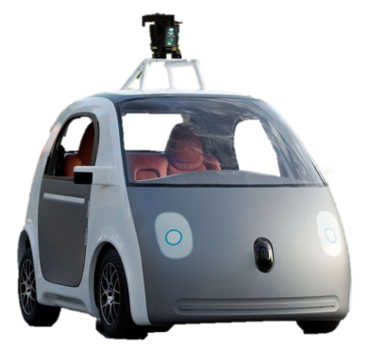
Learning
Conference
Papers
Big
Data
Training
Dashboards and
Reports
Big Model
Drive Actions

Slide 11
Learning
Conference
Papers
Dashboards and
Reports
Big
Data
Training
Big Model
Drive Actions

Slide 12
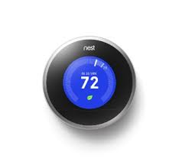


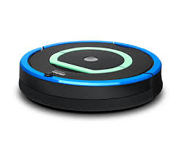


Drive Actions
Learning
Big
Data
Training
Big Model

Slide 13
Learning
Inference
Big
Data
Training
Big Model

Slide 14
Learning
Inference
Big
Data
Query
Training
?
Decision
Big Model
Application

Slide 15
Inference
Learning
Query
Big
Data
Training
Decision
Big Model
Application
Often overlooked
Timescale: ~10 milliseconds
An area of focus in the RISELab

Slide 16
why is challenging?
Inference
Need to render low latency (< 10ms) predictions for complex
Models
Queries
Features
SELECT * FROM
users JOIN items, click_logs, pages WHERE …
Top K
under heavy load with system failures.

Slide 17
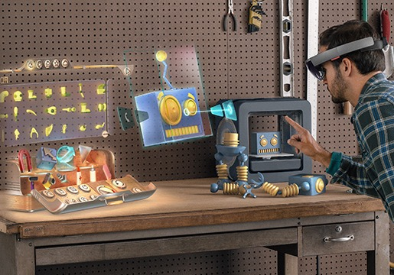

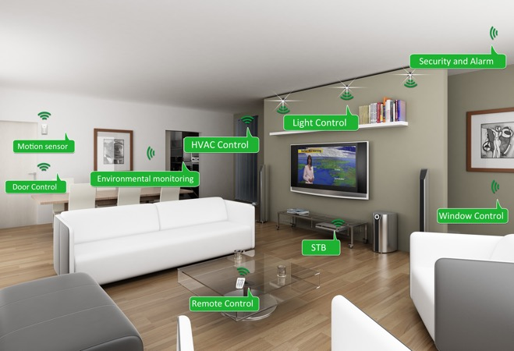
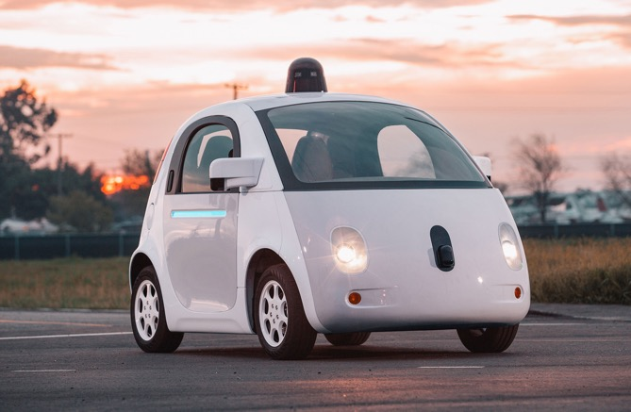
is moving beyond the cloud
Inference
Augmented Reality
Home Security
Home Automation
Mobile
Assistants
Self Driving Cars
Personal Robotics

Slide 18




is moving beyond the cloud
Inference
Opportunities
Reduce latency and improve privacy
Address network partitions
Research Challenges
Minimize power consumption
Limited hardware & long life-cycles
Develop new hybrid models to leverage cloud and devices

Slide 19
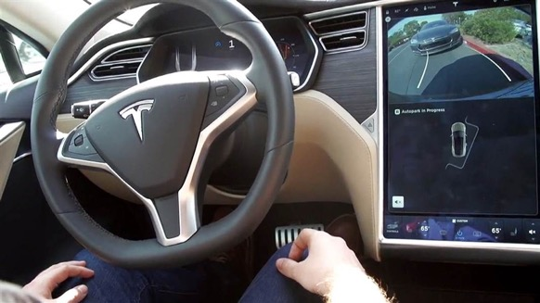
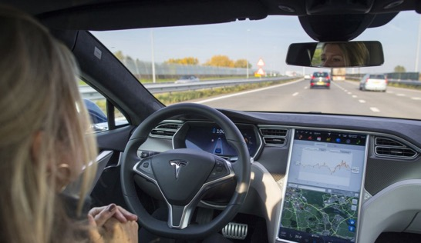
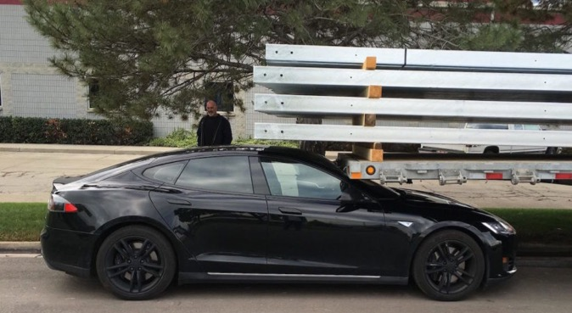
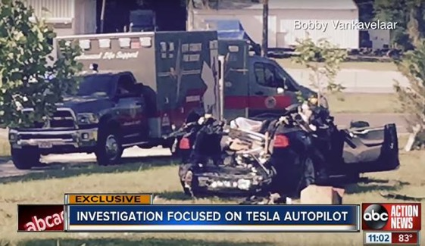
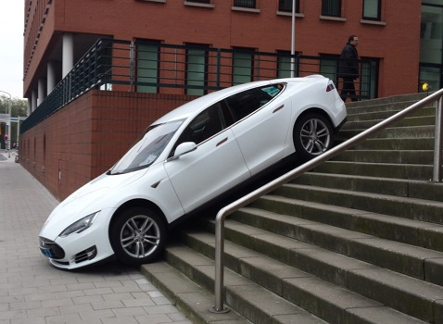
Robust is critical
Inference
Self “Parking” Cars
Self “Driving” Cars
Chat AIs

Slide 20
Learning
Inference
Big
Data
Query
Training
Decision
Big Model
Application
Feedback

Slide 21
Learning
Inference
Training
Decision
Big
Data
Timescale: hours to weeks
Often re-run training
Another area of focus in RISE
Application
Feedback

Slide 22
Why is challenging?
Closing the Loop
Implicit and Delayed Feedback
Self Reinforcing
Feedback Loops
World Changes
at varying rates

Slide 23
Learning
Inference
Big
Data
Query
Training
Responsive
(~10ms)
Adaptive
(~1 seconds)
Decision
Big Model
Application
Feedback

Slide 24
Learning
Inference
Adaptive
(~1 seconds)
Responsive
(~10ms)
Secure
Notes:
Adaptive is hard because of the complex training process that typically revisits the entire data set.
Responsive is hard because of complex often personalized models a elaborate queries

Slide 25
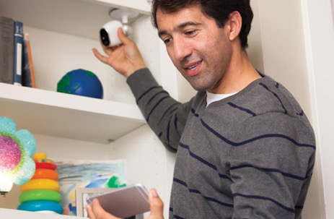
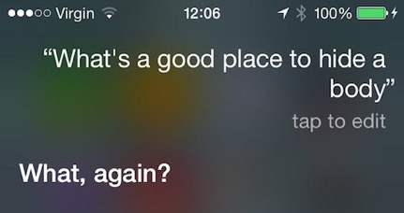
Intelligence in Sensitive Contexts
AR/VR Systems
Home Monitoring
Voice Technologies
Medical Imaging
Protect the data, the model, and the query

Slide 26
Protect the data, the model, and the query
High-Value Data is Sensitive
Medical Info.
Home video
Finance
Models capture value in data
Core Asset
Sensitive
Data
Queries can be as sensitive as the data

Slide 27
Adaptive
Responsive
Secure
Notes:
Adaptive is hard because of the complex training process that typically revisits the entire data set.
Responsive is hard because of complex often personalized models a elaborate queries

Slide 28
Goal
Real-time decisions
decide in ms
on live data
the current state as data arrives
with strong security
privacy, confidentiality, and integrity
decide in ms
Notes:
Questions: (Joey: lets talk tomorrow)
add the staleness dimensions: let’s give an example of the technologies required to reach each point today
why you cannot do it today? : Why can’t we move out to the far right: need to tradeoff accuracy, need fast point queries into massive materialized spaces. Need to keep materialized views up to date
talk about smooth tradeoff? Maybe too complicated? : New algorithms and models to allow elastic tradeoff of accuracy (prediction error), recency (fresh data), and latency (prediction delay)
say more about robustnes
what do you lose? why you can do it today?
advancements in incremental/streaming ML algorithms
a lot of more memory (can precompute much more)
aggressive sampling (anyway deal with statistic results); evaluate multiple models in parallel to recover robustness;
use duplicate requests to reduce tail latency
give a detailed example
New technologies: disaggregation, shared memory, shared storage, huge memory
For slide 4:
Sophisticated algorithms → ability to adapt to different cost tradeoffs in accuracy, latency, and resource availiability all while quantifying accuracy → Blink DB in serving
We need to quantify what we mean by robustness in machine learning: Robust to noisy data and errors in data
For cost lets also emphasize elastic costs: I can always pay more to improve accuracy, latency and robustness or pay less to get all that I NEED which can only be achieved by quantifying prediction accuracy.
Slide 6:
Add a running example. How do we get to each of the points in this tradeoff space today and what is our insight that will take us to the top right?

Slide 29
Goal
Real-time decisions
decide in ms
on live data
the current state as data arrives
with strong security
privacy, confidentiality, and integrity
decide in ms
the current state of the environment
Notes:
Questions: (Joey: lets talk tomorrow)
add the staleness dimensions: let’s give an example of the technologies required to reach each point today
why you cannot do it today? : Why can’t we move out to the far right: need to tradeoff accuracy, need fast point queries into massive materialized spaces. Need to keep materialized views up to date
talk about smooth tradeoff? Maybe too complicated? : New algorithms and models to allow elastic tradeoff of accuracy (prediction error), recency (fresh data), and latency (prediction delay)
say more about robustnes
what do you lose? why you can do it today?
advancements in incremental/streaming ML algorithms
a lot of more memory (can precompute much more)
aggressive sampling (anyway deal with statistic results); evaluate multiple models in parallel to recover robustness;
use duplicate requests to reduce tail latency
give a detailed example
New technologies: disaggregation, shared memory, shared storage, huge memory
For slide 4:
Sophisticated algorithms → ability to adapt to different cost tradeoffs in accuracy, latency, and resource availiability all while quantifying accuracy → Blink DB in serving
We need to quantify what we mean by robustness in machine learning: Robust to noisy data and errors in data
For cost lets also emphasize elastic costs: I can always pay more to improve accuracy, latency and robustness or pay less to get all that I NEED which can only be achieved by quantifying prediction accuracy.
Slide 6:
Add a running example. How do we get to each of the points in this tradeoff space today and what is our insight that will take us to the top right?

Slide 30
Goal
Real-time decisions
decide in ms
on live data
the current state as data arrives
with strong security
privacy, confidentiality, and integrity
decide in ms
the current state of the environment
privacy, confidentiality, integrity

Slide 31
Challenges
RISE Lab
Real-time, sophisticated decisions that guarantee worst-case behavior on noisy and unforseen live data
Automated decisions
on live data are hard
Poor security: exploits are daily occurrences
Ensure privacy and integrity
without impacting functionality
One-off solutions, expensive and slow
to build
General platform: Secure Real-time Decision Stack

Slide 32




Example: Zero-time defense
Problem: zero-day attacks can compromise millions of sites in seconds
Solution: analyze network flows to detect attacks and patch sites/software in real-time
Intermediate data: create attack model
Decision: detect attack, patch
Quality | sophisticated, accurate, robust
Latency | sec (decision) / sec (update)
Security | privacy (encourage users to share logs), integrity
Notes:
In real talks we will pick only a few of these examples.

Slide 33
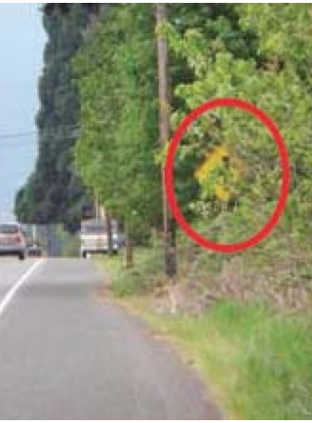
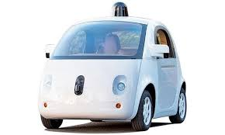
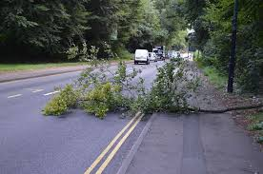
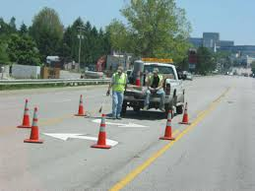
Example: “Fleet” driving
Problem: suboptimal driving decisions
Solution: collect & leverage info from other cars and drivers in real-time
Intermediate data: automatically annotate maps, actions of other drivers
Decision: avoid obstacles, congestions
Quality | sophisticated, accurate, noise tolerant
Performance | sec (decision) / sec (update)
Security | privacy, data integrity

Slide 34
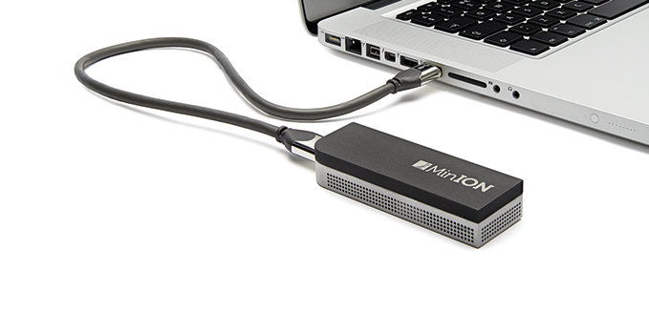
Example: Infectious disease discovery
Problem: infectious diseases spread quickly (Zika), may need quarantine (Ebola)
Solutions: real-time DNA seq. & analysis to identify pathogens
Rapid analysis to trace evolution, source
100x faster → 100x people tested
Intermediate data: evolution, spread, symptoms
Decision: quarantine or not, diagnosis
Quality | sophisticated, accurate
Latency | min (decision) / hour (update)
Security | privacy, integrity
MinION Nanopore
(Dr. Charles Chiu UCSF using it
to identify Zika virus)

Slide 35
Applications | Quality | Latency |  | Security
 |  | Decision | Update
Zero-time defense | sophisticated, accurate, robust | sec | sec | privacy/confidentiality, integrity
Parking assistant | sophisticated, robust | sec | sec
Disease discovery | sophisticated, accurate | sec/min | hours
IoT (smart buildings) | sophisticated, robust | sec | min/hour
Earthquake warning | sophisticated, accurate, robust | ms | min
Chip manufacturing | sophisticated, accurate, robust | sec/min | min
Fraud detection | sophisticated, accurate | ms | min
“Fleet” driving | sophisticated, accurate, robust | sec | sec
Virtual companion | sophisticated, robust | sec | min/hour
Video QoS at scale | sophisticated | ms/sec | min

Slide 36
Challenges
RISE Lab
Real-time, sophisticated decisions that guarantee worst-case behavior on noisy and unforseen live data
Automated decisions
on live data are hard
Poor security: exploits are daily occurrences
Ensure privacy and integrity
without impacting functionality
One-off solutions, expensive and slow
to build
General platform: Secure Real-time Decision Stack

Slide 37

A bird’s eye view
decision
query
Secure Real-time Decision Stack
push decision
end-point info
…
end-points
(e.g., users, devices)

Slide 38
What exists today?

Slide 39
Pull decisions
Example: recommendation system
recommendation
Service Layer
(WebApp, Cassandra, MySQL)
per-user recommendations
request
ETL/ML
(Hadoop, Spark, Cloud Dataflow)
collaborative filtering
Ingestion
(Kafka)
…
Storage (HDFS)
user purchase
and rating history
Notes:
Focus on open source
If you use a keyvalue store as request, you can precompute all of them, space would be too unmanageable if

Slide 40
Pull decisions
Cannot pre-compute all decisions
Cannot touch much data
Problem: cannot have sophisticated decisions
decision
ms
Service Layer
(WebApp, Cassandra, MySQL)
request
min/day
ETL/ML
(Hadoop, Spark, Cloud Dataflow)
Ingestion
(Kafka)
…
Storage (HDFS)

Slide 41
Pull decisions
Cannot pre-compute all decisions
Cannot touch much data
decision
ms
Service Layer
(WebApp, Cassandra, MySQL)
request
min/day
insecure
ETL/ML
(Hadoop, Spark, Cloud Dataflow)
Ingestion
(Kafka)
…
secure
(encryption at rest)
Storage (HDFS)

Slide 42
Solution scorecard
Solution | Decision Quality | Latency |  | Security
 |  | Decision | Update
Pull decisions | simple | ms | min/day | weak

Slide 43
Pull decisions: contextual decisions
decision
light-weight, ensemble and correction models, policies
Prediction Serving Layer
(WebApp, Velox, on-line MWT)
request
ML
(Hadoop, Spark, Cloud Dataflow)
Ingestion
(Kafka)
off-line, large models
…
Storage (HDFS)
Notes:
A new set of systems developed
Mwt multi word testing
More advanced serving side – aggregate the recommendation for different models and make a good prediction
They are too specialzied for one app

Slide 44
Solution scorecard
Solution | Decision Quality | Latency |  | Security
 |  | Decision | Update
Pull decisions | simple | ms | min/day | weak
Pull decisions: prediction service | sophisticated, specialized | ms | min* | weak
*light-weight, ensemble + correction models, policies

Slide 45
Push Decisions
Example: anomaly detection
alert
outlier
detection
Streaming
(Storm, Spark, IBM Streams)
support vector machine (SVM)
Ingestion
(Kafka)
ETL/ML
(Hadoop, Spark)
…
Storage (HDFS)
machine logs

Slide 46
Push Decisions
Example: anomaly detection
alert
outlier
detection
Streaming
(Storm, Spark, IBM Streams)
ms/sec
hour
support vector machine (SVM)
Ingestion
(Kafka)
ETL/ML
(Hadoop, Spark)
…
Storage (HDFS)
machine logs

Slide 47
Solution scorecard
Solution | Decision Quality | Latency |  | Security
 |  | Decision | Update
Pull decisions | simple | ms | min/day | weak
Push decisions | simple | ms/sec | hour | weak
*light-weight, ensemble + correction models, policies

Slide 48
Security tools
Computation on encrypted data
Hardware enclaves

Slide 49
State-of-the-art security solutions: Computation on encrypted data
decision
Web
App
Key-value store
(Cassandra, MySQL)
request
Ingestion
(Kafka)
ETL/ML
(Hadoop, Spark)
…
Storage (HDFS)

Slide 50



State-of-the-art security solutions: Computation on encrypted data
decision
SQL (CryptDB), ML classification, web serving (Mylar), etc.
Web
App
Key-value store
(Cassandra, MySQL)
request
Ingestion
(Kafka)
ETL/ML
(Hadoop, Spark)
…
user info
Storage (HDFS)
Ensure security, but relatively simple algorithms

Slide 51
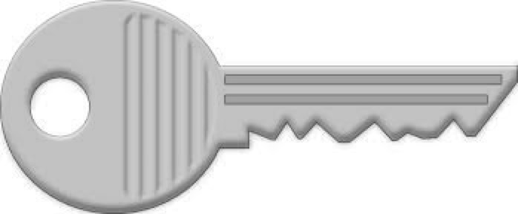
State-of-the-art security solutions: Hardware enclaves
Intel SGX, ARM Trustzone, RISC V (e.g., Haven, VC3)
decision
Confid
Web
App
Key-value stpre
(Cassandra, MySQL)
request
Confid
Ingestion
(Kafka)
ETL/ML
(Hadoop, Spark)
…
user info
Storage (HDFS)
TCB, side-channel leakage

Slide 52
Solution scorecard
Solution | Decision Quality | Latency |  | Security
 |  | Decision | Update
Pull decisions | simple | ms | min/day | weak
Push decisions | simple | ms/sec | hour | weak
State-of-the-art security | simple | ms | min/hour | strong
*light-weight, ensemble + correction models, policies

Slide 53
Solution scorecard: RISE
Solution | Decision Quality | Latency |  | Security
 |  | Decision | Update
Pull decisions | simple | ms | min/day | weak
Push decisions | simple | ms/sec | hour | weak
Security | simple | ms | min/hour | strong
RISE | sophisticated, accurate, robust | ms | sec | strong
*light-weight, ensemble + correction models, policies

Slide 54
Research areas
Systems: Spark-like functionality with 100x lower response time, and 1000x higher job throughput
Machine Learning:
On-line ML algorithms
Robust algorithms: handle noisy data, guarantee worst-case behavior
Security: achieve privacy, confidentiality, and integrity without impacting performance

Slide 55
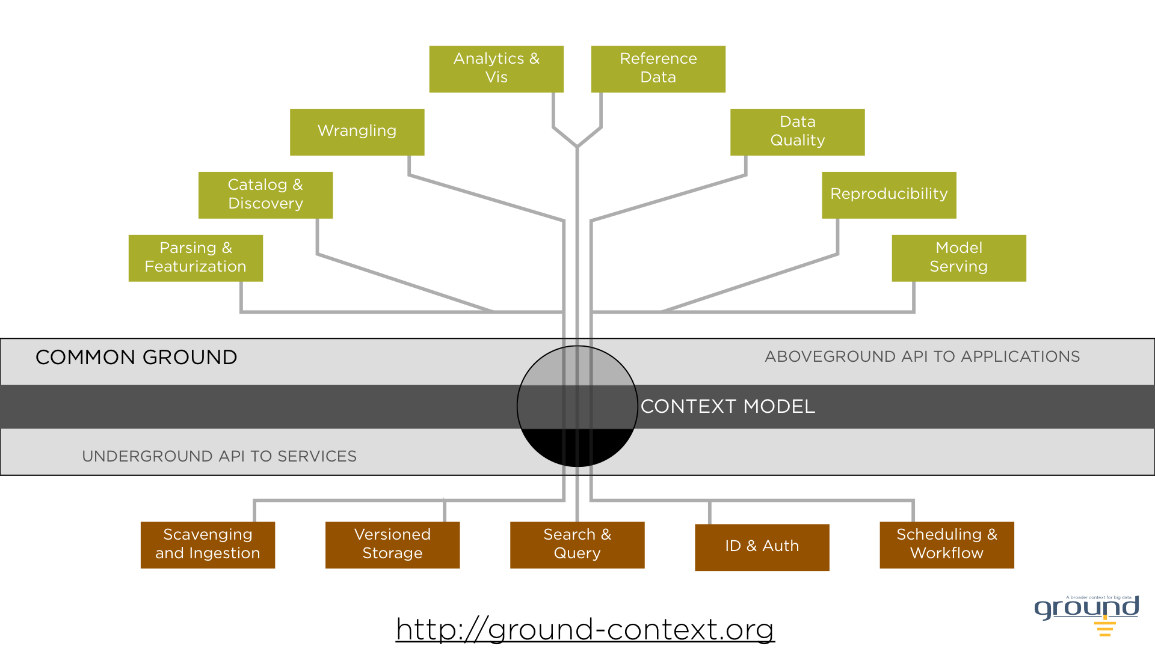
Early Projects

Slide 56

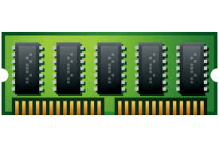
Research area: Systems
on-going work
future work
Apache
LatticeFlow
Ray
Clipper
…
unified model
(rich experience w/ both models)
shim layer
shim layer
shim layer
shim layer
…
RISE
μkernel
IndexedRDDs
scheduler
optimizer
GPU/ASICs algos
in-memory object store
Support task-graph & BSP execution models
Support fine grain updates
Support heterogeneous hardware
Millisecond level parallel jobs
Handle 10K-100K jobs/sec
Ability to faithfully replay jobs
Drizzle
sharded driver,
in-memory processing,
per-core NIC, HBM
system-state store

Slide 57
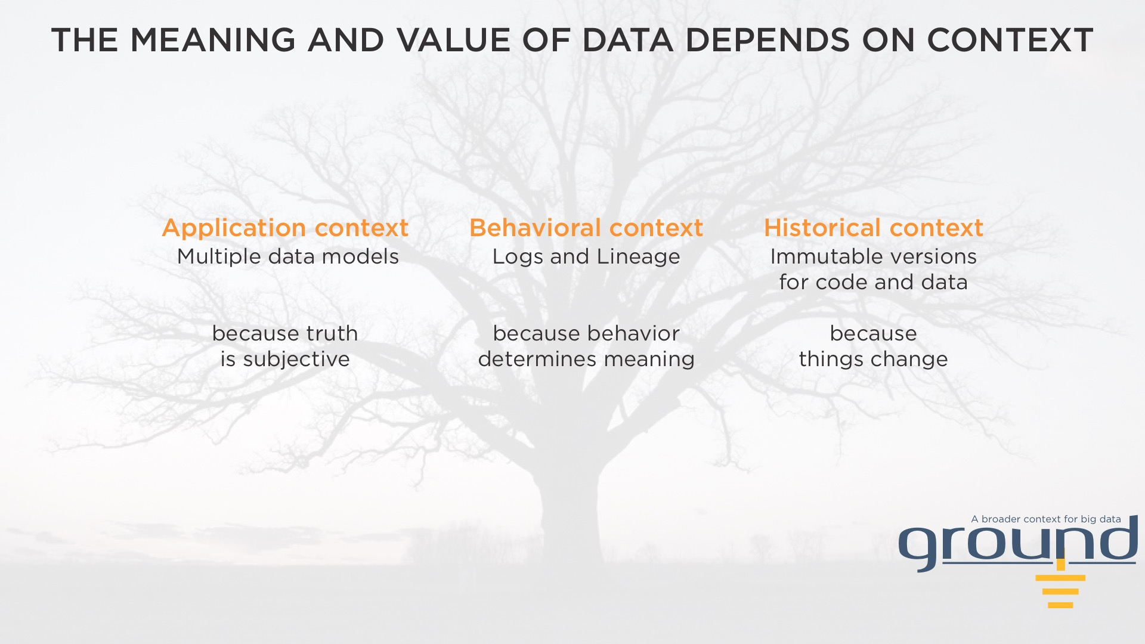

Slide 59
LatticeFlow and Bedrock (working names)
Driving Hypotheses for LatticeFlow
A core programming API for both real-time and scale
Everything is (async) data: event dispatch, real-time data streams
Coordination Avoidance: lattices + async dataflow = no locks/barriers
Initial proof point this fall: LatticeKVS
MultiScale, MultiConsistency key-value store
Same system beats Redis on one node, Cassandra on scale-out…
…while providing family of rich consistency and transactional isolation options
…with lean codebase, derived from a core LatticeFlow library in C++
Prototype toward “Project Bedrock”
Immutable, never-forget versioned storage under ground

Slide 60




Research area: Systems & ML
Focus on robust,
on-line algorithms
App
Layer
ML algorithms, Tools, Apps
Apache
Ray
Clipper
Succinct
Focus on
ML/DL support
(e.g., Clipper, Ray)
…
shim layer
shim layer
shim layer
shim layer
Comp.
Layer
…
RISE
μkernel
scheduler
optimizer
already gathering
industry support
in-memory object store
RISE
Ground (metadata manager)
Storage
Layer
3rd party
RISE + 3rd party

Slide 61
Research area: ML
Robust optimization methods:
noise tolerant and parallelizable
Handle uncertainty:
robust control techniques to handle unforseen real world situations
Quantify decision accuracy:
confidence and credible intervals on outputs of ML systems
On-line ML algorithms
handle time-varying models with high performance and reliability

Slide 62
End-to-end system
decision
ML algorithms, Tools, Apps
query
Apache
Ray
Clipper
Succinct
decision
Secure Real-time
Decision Stack
…
shim layer
shim layer
shim layer
shim layer
…
RISE
μkernel
scheduler
optimizer
in-memory object store
…
Ground (metadata manager)

Slide 63
Research area: Security
decision
ML algorithms, Tools, Apps
query
Apache
Ray
Clipper
Succinct
decision
…
shim layer
shim layer
shim layer
shim layer
…
RISE
μkernel
scheduler
optimizer
in-memory object store
…
Ground (metadata manager)
Split comp. between enclave and on encrypted data

Slide 64
Research area: Security
ML (decisions) on encrypted data
ML algorithms, Tools, Apps
Apache
Ray
Clipper
Succinct
Opaque: oblivious &
encrypted analytics
…
shim layer
shim layer
shim layer
shim layer
New hardware support (RISC V, HBM)
…
RISE
μkernel
scheduler
optimizer
in-memory object store
Fine grained
access control
Ground (metadata manager)
Arx: queries
on encrypted data

Slide 65

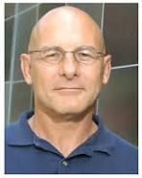


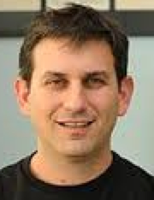








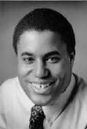
Why now, why us?
Hardware Trends
Processing
RISC V*, GPUs, ASICs
Built in security support (enclaves)
Storage & networking
3D Xpoint
Next gen rack designs
FireBox*
Latency
Systems
Berkeley’s BDAS*
Quality
Machine Learning
Robust algorithms*
On-line ML* and DL
Security
Security
Code verification tools*
Comp. on encrypted data*
*blue indicates areas in which we are leaders
Notes:
Michael mahoney

Slide 66
Summary
Goal: develop Secure Real-time Decision Stack,
an open source platform, tools and algorithms
for real-time decisions on live data with strong security
Five year project, similar to AMPLab
We are uniquely positioned to tackle this challenge
Looking to partner with companies

